Slide 1
Credit Card Default Risk Analysis
BY,
Bharath P
1

Slide 2


Who Should Care?
Credit Card Companies
Commercial Banks
3

Slide 3
Approach Overview
Data Cleaning
Data Exploration
Predictive Modeling
Understand and Clean
Graphical and Statistical
Machine Learning
Find information on undocumented columns values
Clean data to get it ready for analysis
Exam data with visualization
Verify ﬁndings with statistical tests
Logistic Regression
Random Forest
XGBoost
4

Slide 4
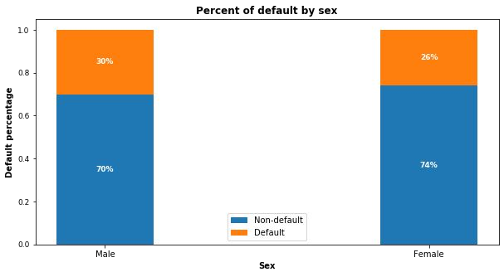
Gender Variable
30% of males and 26% of females have payment default.

Slide 5
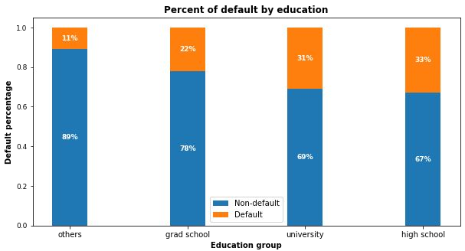
Education Variable
Higher education level, lower default risk.
“Others” only consists 1.56% of total customers even if they appear to have the least default.

Slide 6
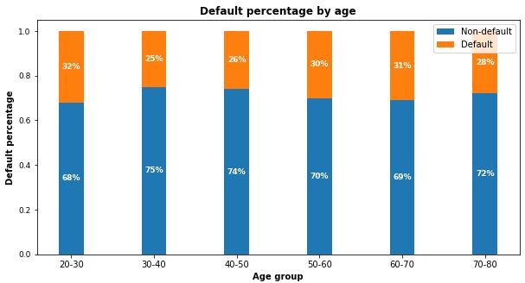
Age Variable
30-50:
Lowest risk
< 30 or >50:
Risk increases

Slide 7
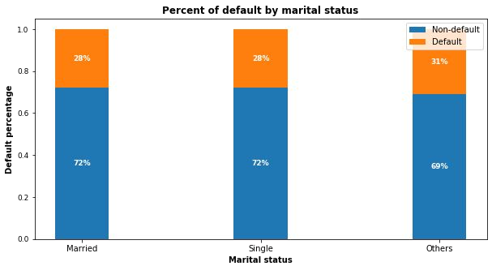
Marital Status Variable
No signiﬁcant correlations of default risk and marital status

Slide 8
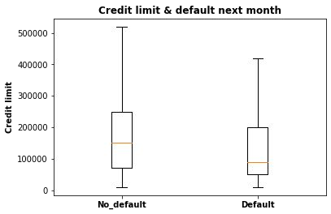
Credit Limit Variable
Higher credit limits,
lower default risk.

Slide 9
EDA Summary
Demographic factors that impact default risk are:
Education: Higher education is associated with lower default risk.
Age: Customers aged 30-50 have the lowest default risk.
Sex: Females have lower default risk than males in this dataset.
Credit limit: Higher credit limit is associated with lower default risk.

Slide 10
Modeling Overview
Deﬁne Problem:
Supervised learning / binary classiﬁcation
Imbalanced Classes:
78% non-default vs. 22% default
Tools Used:
Scikit learn library and imblearn
Models Applied:
Logistic Regression / Random Forest / XGBoost

Slide 11
Modeling Steps
Data Preprocessing
Fitting and Tuning
Model Evaluation
Feature selection
Feature engineering
Train-test data splitting (70%/30%)
Training data rescaling
SMOTE oversampling
Start with default model parameters
Hyperparameters tuning
Measure ROC_AUC on training data
Models testing
Precision_Recall score
Compare with sklearn dummy classiﬁer
Compare within the 3 models

Slide 12
Correct Imbalanced Classes
Fit every model without and with SMOTE oversampling for comparison.
Training AUC scores improved signiﬁcantly with SMOTE.
Models | AUC Without SMOTE | AUC With SMOTE
Logistic Regression | 0.726 | 0.797
Random Forest | 0.764 | 0.916
XGBoost | 0.762 | 0.899

Slide 13
Hyperparameters Tuning
K-Fold Cross Validation to get average performance on the folds.
Randomized Search on Logistic Regression since C has large search space.
Grid Search on Random Forest on limited parameters combinations.
Randomized Search on XGBoost because multiple hyperparameters to tune.

Slide 14
Model Comparisons
Compare the models to Scikit-learn’s dummy classiﬁer.
All models performed better than dummy model.
Models | Precision | Recall | F1 Score | Conclusion
Dummy Model | 0.217 | 0.500 | 0.303 | Benchmark
Logistic Regression | 0.384 | 0.566 | 0.457 | Best recall
Random Forest | 0.513 | 0.514 | 0.514 | Best F1
XGBoost | 0.444 | 0.505 | 0.474

Slide 15
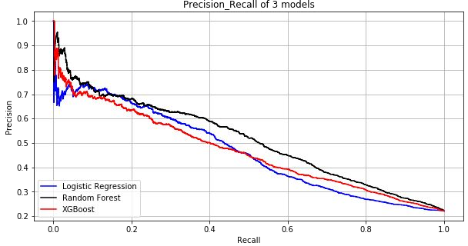
Model Comparisons
Compare within 3 models.
Random Forest (black line) has the best precision_recall score.
Terminology:
★ Recall: how many 1s are being identiﬁed?
★ Precision: Among all the 1s that are ﬂagged, how many are truly 1s?
★ Precision and recall trade-off: high recall will cause low precision

Slide 16
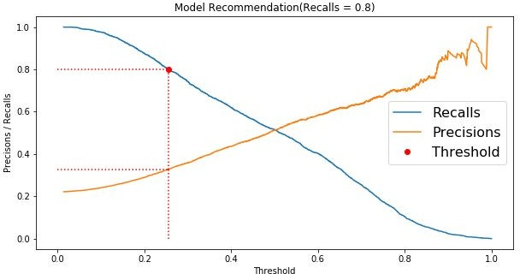
Model Usage - Recommendation
I.e. recall = 0.8. Threshold can be adjusted to reach higher recall.

Slide 17
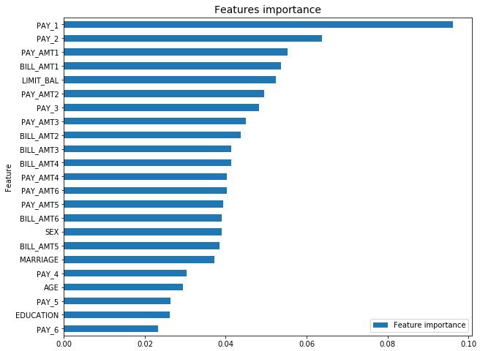
Feature Importances
Best model Random Forest feature importances plot.
★ PAY_1: most recent month’s payment status.
★ PAY_2: the month prior to current month’s payment status.
★ BILL_AMT1: most recent month’s bill amount.
★ LIMIT_BAL: credit limit

Slide 18
Conclusions
Recent 2 payment status and credit limit are the strongest default predictors.
Dormant customers can also have default risk.
Random Forest has the best precision and recall balance.
Higher recall can be achieved if low precision is acceptable.
Model can be served as an aid to human decision.
Suggest output probabilities rather than predictions.
Model can be improved with more data and computational resources.

Slide 19
Thank you!

